Slide 1
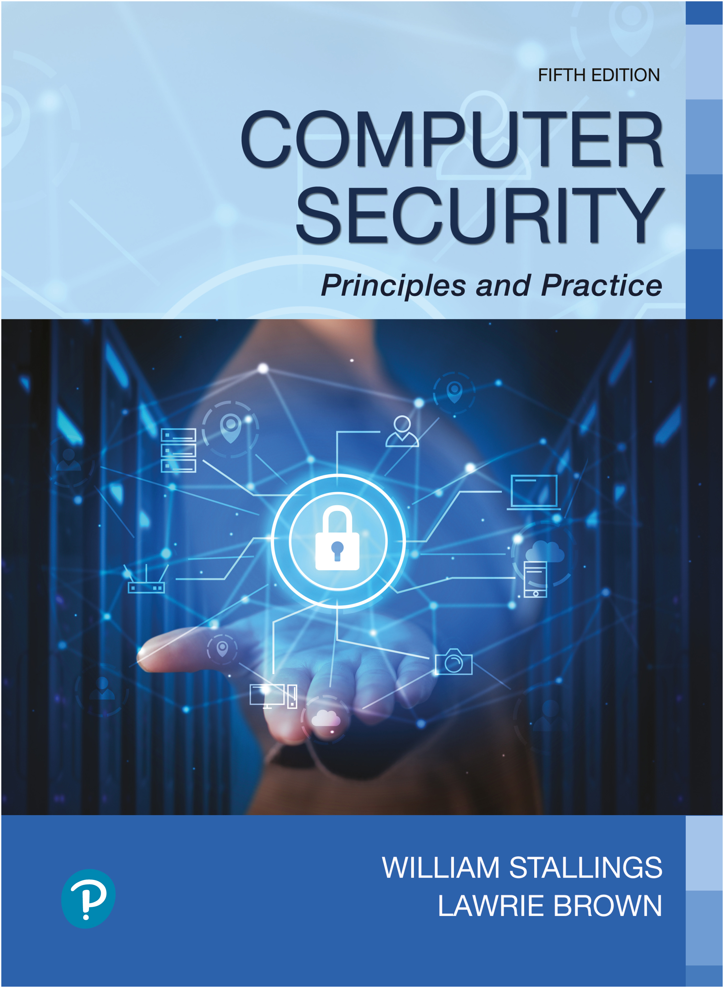

Computer Security: Principles and Practice
Fifth Edition
Chapter 17
Human Resources Security
Copyright © 2024, 2018, 2015 Pearson Education, Inc. All Rights Reserved
Notes:
If this PowerPoint presentation contains mathematical equations, you may need to check that your computer has the following installed:
1) MathType Plugin
2) Math Player (free versions available)
3) NVDA Reader (free versions available)
This chapter covers a number of topics that, for want of a better term, we categorize as human resources security. The subject is a broad one, and a full discussion is well beyond the scope of this book. In this chapter, we look at some important issues in this area.

Slide 2

Quotes from Bruce Schneier
If you think technology can solve your security problems, then you don't understand the problems and you don't understand the technology. Bruce Schneier /
Mr. Schneier said the attacks are more like a traditional con game than a technically sophisticated intrusion. “This is hacking the person,” he said. “It’s not hacking the computer.” (NY Times 6/2/2011)
“People often represent the weakest link in the security chain and are chronically responsible for the failure of security systems.”
Walt Kelly, Pogo
SJW

Slide 3
Preet Bharara*
Every company needs to do a better job of creating and fostering a culture of security.
Even simple measures — like employee training and regular threat assessments — can help companies avoid becoming the easy target.
The … mundane reality is that companies are most often breached by hackers walking down virtual hallways, looking for a single unlocked door.
A recent report by Verizon suggests that a stunning 97 percent of data breaches last year were avoidable.
*U.S. Attorney for the Southern District of New York, appointed by Obama and fired by Trump in his first termafter promising Sen. Schumer he would retain him
SJW

Slide 4
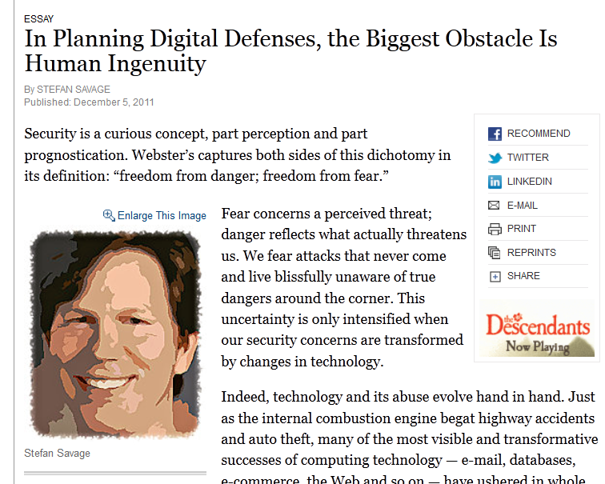
A Good Place to Start…
“But security is at its heart a human issue. It is about conflict, and computers are merely a medium by which conflict can be expressed. The future of computer security, then, is less about the future of technology than it is about the future of human relations.”
Center for Automotive Embedded Systems Security
SJW
Notes:
Evolution of computer abuse — and therefore of computer security — is driven by commerce.
Emerging cellphone-based payment systems, automated banking transfers and the increasingly liquid markets for online goods in multiplayer games will all be ripe targets for online crooks.
Another is the large-scale collection and use of personal data.
As we leave ever more detailed online footprints — via purchasing, browsing and social relationships — a vast “big data” ecosystem has emerged to collect, process and resell this information. Concerns about this issue are typically framed in terms of privacy: How much do I want others to know about me? How might it affect my ability to get health insurance, employment or credit?
This data might be used — not just to extract information about people’s desires and social relationships, but to use that understanding to affect their behavior. Nor would this be limited to the banal goal of getting you to purchase a particular product; it could be used for Internet-scale social monitoring and manipulation.
The ease with which we adopt online personas and relationships has created a collective blind spot that computer technology is well suited to exploit. Advances in natural-language processing and data mining make it entirely feasible to mint millions of “social bots,” each establishing online friendships with their targets like virtual con men, each building trust over time and delivering personalized messages designed to elicit information, sway opinion or call to action.
This idea, which one of my colleagues has called “social architecture,” completely upends traditional computer security concerns: The threat is not of humans controlling or monitoring our computers, but precisely the converse.
A particularly troubling precedent because computing capabilities are now embedded in virtually every aspect of our lives. The power we use, the water we drink, the cars, planes and trains we travel in, the elevators and air-conditioning in our buildings, even many of our children’s toys — all are controlled by computers.
A parallel trend, fueled by cheap wireless connectivity, is that these devices are increasingly networked. And while few of these systems have been attacked in anger, it is this very fact that leads most of them to be rife with vulnerabilities — a sheltered ecosystem with no immunity to attacks from an outside invader.
My colleagues and I demonstrated weaknesses that allowed us to remotely infiltrate, track and control popular automobiles more than 1,000 miles away. Other researchers have demonstrated remote attacks on implantable cardiac defibrillators, smart power meters, utility control networks and so on.
The crucial question is whether these are merely Chicken Little fears or real dangers. And the answer will be a matter not of technology but of politics. Do conflicting powers believe that such attacks will advance their aims better than alternatives, that they are worth the effort to develop, that they are worth the risks of retaliation?
But security is at its heart a human issue. It is about conflict, and computers are merely a medium by which conflict can be expressed. The future of computer security, then, is less about the future of technology than it is about the future of human relations.

Slide 5

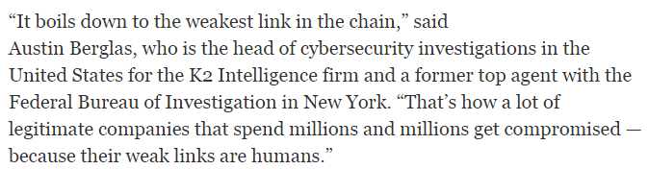
“Their Weak Links are Humans”
SJW

Slide 6
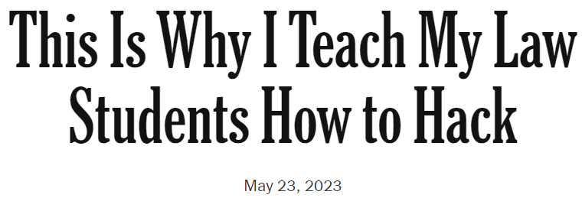
The Human Factor
My larger aim is to put technical expertise in its place: I want my students to realize that technology alone is not enough to solve the problems we face. Figuring out how hacking works is the easy part. Figuring out how humans work, and what to do about it, is the hard part.
SJW

Slide 7

The Human Factor
SJW

Slide 8
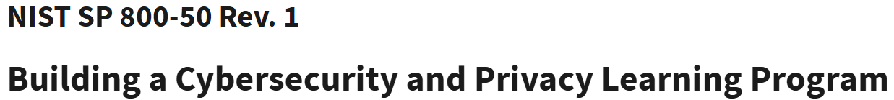
Security Awareness, Training, and Education
The topic of security awareness, training, and education is mentioned prominently in a number of standards and standards-related documents, including I S O 27002 (Information security, cybersecurity and privacy protection — Information security controls, 2022 and N I S T S P 800-50 (Building a Cybersecurity and Privacy Learning Program), September 2024
SJW
Notes:
The topic of security awareness, training, and education is mentioned prominently in a number of standards and standards-related documents, including I S O 27002 (Code of Practice for Information Security Management, 2013) and N I S T S P 800-50 (Building an Information Technology Security Awareness and Training Program, October 2003). This section provides an overview of the topic.

Slide 9
Benefits to Organizations
Security awareness, training, and education programs provide four major benefits to organizations:
Improving employee behavior
Increasing employee accountability
Mitigating liability for employee behavior
Complying with regulations and contractual obligations
Notes:
Security awareness, training, and education programs provide four major benefits to organizations:
• Improving employee behavior
• Increasing the ability to hold employees accountable for their actions
• Mitigating liability of the organization for an employee’s behavior
• Complying with regulations and contractual obligations

Slide 10
Human Factors
Employee behavior is a critical concern in ensuring the security of computer systems and information assets
Principal problems associated with employee behavior are:
Social engineering and phishing attacks
Compromised or weak credentials
Errors and omissions
Fraud
Actions by disgruntled employees
Notes:
Employee behavior is a critical concern in ensuring the security of computer systems and information assets. For many years, reports such as [V E R I 22] have found that employee actions, both malicious and unintentional, were involved in a large number of security incidents involving exposure of data. The principal problems associated with employee behavior are social engineering and phishing attacks, compromised or weak credentials, errors and omissions, fraud, and actions by disgruntled employees. In particular, they identify phishing attacks and compromised credentials, such as passwords, as the top two methods that attackers use to gain access to an organization. Security awareness, training, and education programs can assist in reducing incidences of these problems.
Such programs can serve as a deterrent to fraud and actions by disgruntled employees by increasing employees’ knowledge of their accountability and of potential penalties. Employees cannot be expected to follow policies and procedures of which they are unaware. Further, enforcement is more difficult if employees can claim ignorance when caught in a violation.
Ongoing security awareness, training, and education programs are also important in limiting an organization’s liability. Such programs can bolster an organization’s claim that a standard of due care has been taken in protecting information.
Finally, security awareness, training, and education programs may be needed to comply with regulations and contractual obligations. For example, companies that have access to information from clients may have specific awareness and training obligations that they must meet for all employees with access to client data.

Slide 11
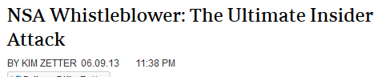
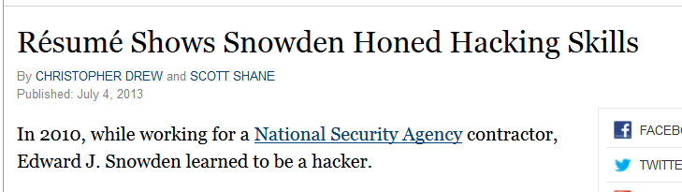
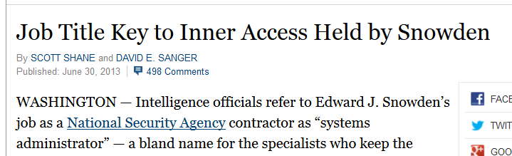
Edward Snowden - The Ultimate Insider Attack
“… took a course that trains security professionals to think like hackers and understand their techniques… became a “certified ethical hacker”.
“… The certification would also have given him some of the skills he needed to rummage undetected through N.S.A. computer systems ….”
What Is an Insider Threat?
SJW

Slide 12
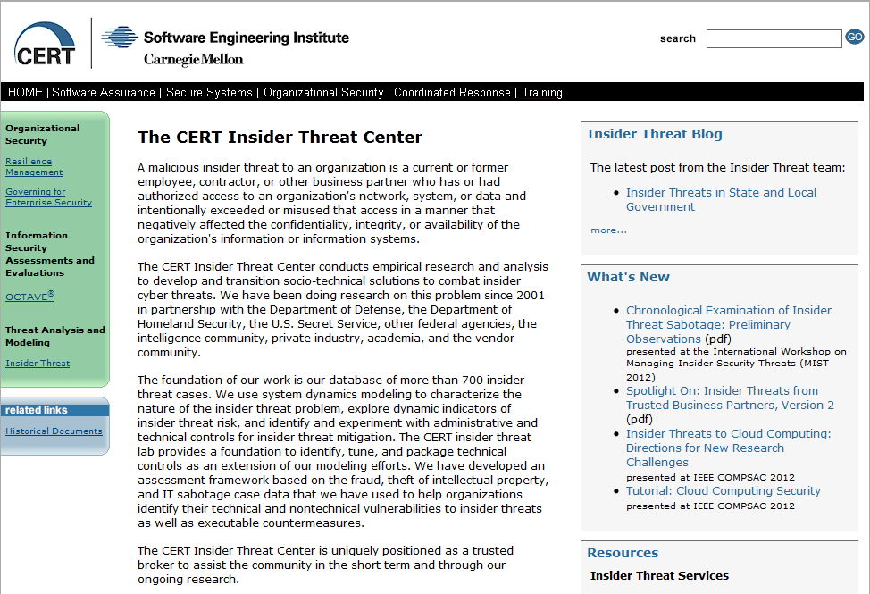
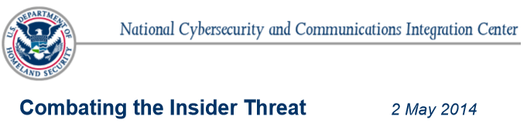
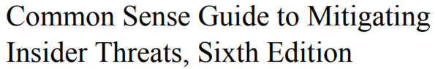
CERT Insider Threat Center
SJW

Slide 13
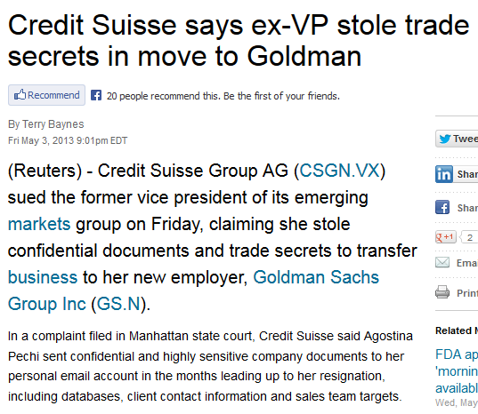
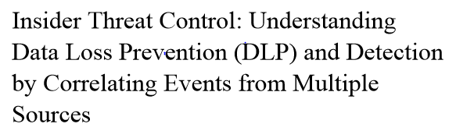
Insider Threats
This report focuses on the theft of intellectual property using removable media, in particular, USB devices. We present methods to control removable media devices in a Microsoft Windows environment using Group Policy within an Active Directory environment. We also explore OpenDLP, an open source tool for identifying where sensitive data resides on organizational systems.
SJW

Slide 14
Programmer Indicted in Theft of Goldman Software (2010 1 of 2)
Programmer of high-frequency trading platform
Paid $220,00/year at GS, then $400,000 after Barclays made offer. Competitor offered 3X.
Joined competitor
Copied thousands of files of (mostly open) source code and sent them to his home
Encrypted other files and stored them on server in Germany
Deleted encryption program
SJW
Notes:
Table 6.1c, based on [RADC04] summarizes examples of insider behavior.

Slide 15
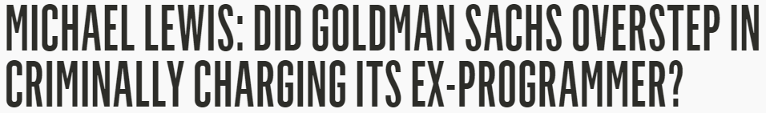
Programmer Indicted in Theft of Goldman Software (2010 2 of 2)
Deleted bash history
GS maintained two logs – he was only aware of one
Caught because GS noticed unusual traffic volume
3/18/2011 - sentenced to 8 years
2/21/2012 – released on technicality (federal appeals court ruled that computer code was not tangible property)
10/2012 – charged under NYS law (covers computer programs)
5/1/2015: split verdict: convicted of illegal use of secret material; acquitted of illegal duplication of computer material
July 6, 2015: Judge sets aside jury’s verdict
2017: conviction reinstated; appealed
Sentenced to time served
Courts struggling with application of laws to computer technology, said Stephen McJohn, a professor at Suffolk University Law School in Boston. Judges and juries rely on statutes that didn’t contemplate present technology.
Bruce Schneier: This type of corporate crime — of a former employee leaving a company with data he should not have — occurs quite regularly
SJW
Notes:
Table 6.1c, based on [RADC04] summarizes examples of insider behavior.

Slide 16
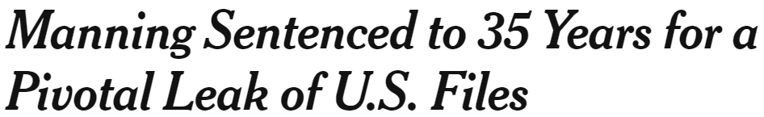

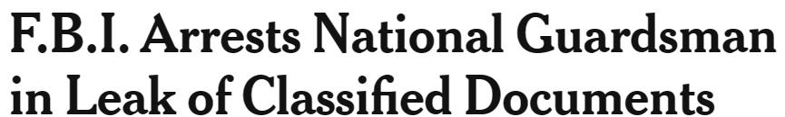
Government Leaks
Chelsea Manning gave WikiLeaks 700,000 classified diplomatic cables in 2010
President Obama establishes task force charged with “deterring, detecting and mitigating insider threats, including the safeguarding of classified information from exploitation, compromise, or other unauthorized disclosure.”
U.S. tried to extradite Julian Assange from UK for more than a decade
Snowden’s job was to move large amounts of data between different parts of the system
NSA Hawaii office had not yet installed monitoring software
downloaded documents over several months
logged into classified systems using others’ passwords
hacked firewalls
Jack Teixeira was a communications technician in National Guard
Used Discord to share secret documents with his friends
SJW
Notes:
Table 6.1c, based on [RADC04] summarizes examples of insider behavior.
Chelsea Manning - Life, Jail & Facts – Biography Chelsea Manning, who was born as Bradley Manning, joined the Army in 2007 and was sent to Iraq in 2009. There she had access to classified information that she described as profoundly troubling. Manning gave much of this information to WikiLeaks and was later arrested after her actions were reported to the U.S. government by a hacker confidant. On July 30, 2013, Manning was found guilty of espionage and theft, but not guilty of aiding the enemy and sentenced to 35 years in prison. President Barack Obama commuted Manning's remaining sentence, and she was released from prison on May 17, 2017.

Slide 17




Human Factors
“WannaCry” – see Chapter Six
SJW

Slide 18
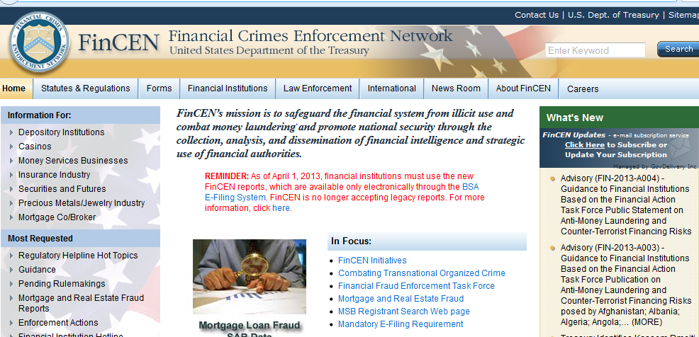
New Reporting Requirements
SJW

Slide 19
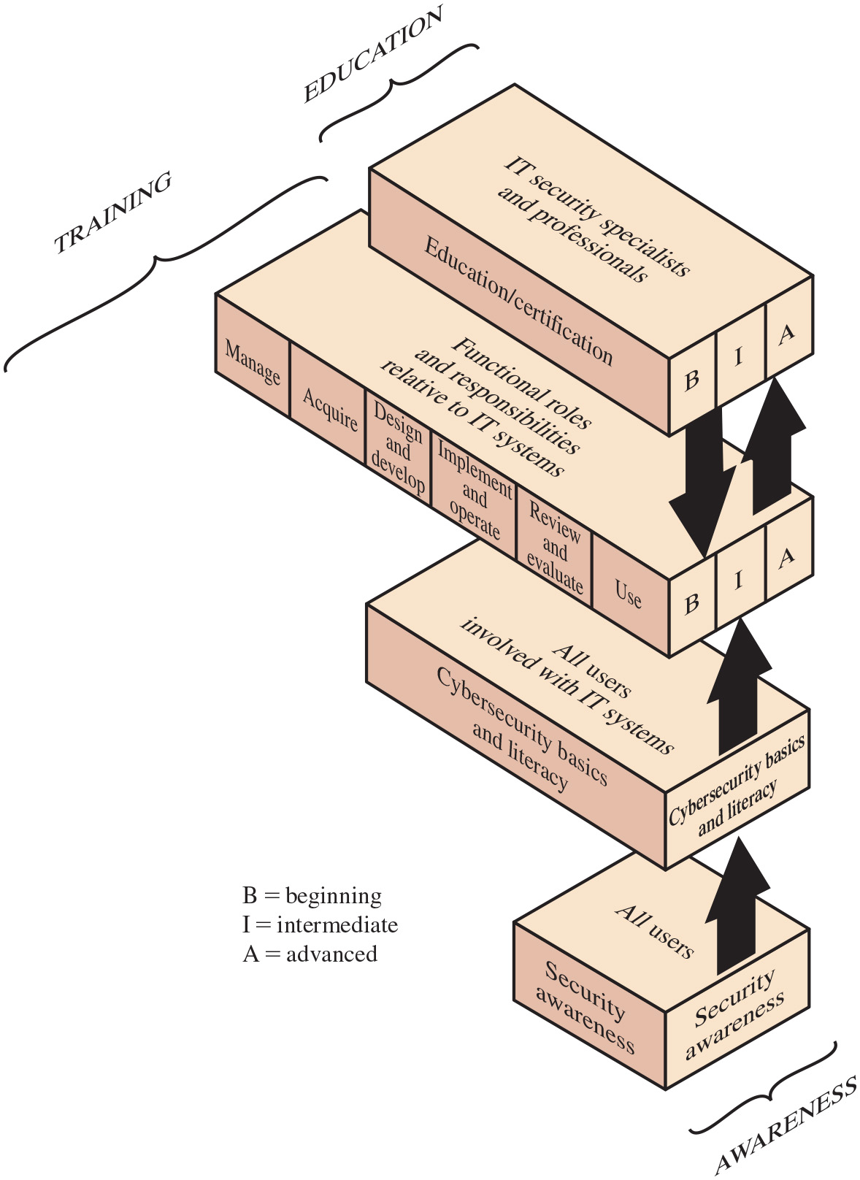
Figure 17.1
Information Technology (I T) Learning Continuum
The learning objective with respect to security depends on the employee’s role
Why: Understanding
Transition between awareness and training
How: Skill
What: Recognition
SJW
Notes:
A number of N I S T documents, as well as I S O 27002, recognize that the learning objectives for an employee with respect to security depend on the employee’s role. There is a need for a continuum of learning programs that starts with awareness, builds to training, and evolves into education. Figure 17.1 shows a model that outlines the learning needed as an employee assumes different roles and responsibilities with respect to information systems, including equipment and data. Beginning at the bottom of the model, all employees need an awareness of the importance of security and a general understanding of policies, procedures, and restrictions. Training, represented by the two middle layers, is required for individuals who will be using I T systems and data and, therefore, need more detailed knowledge of I T security threats, vulnerabilities, and safeguards. The top layer applies primarily to individuals who have a specific role centered on I T systems, such as programmers and those involved in maintaining and managing I S assets and those involved in I T security.
N I S T S P 800-50 summarizes the four layers as follows:
• Security awareness is a set of activities that explains and promotes security, establishes accountability, and informs the workforce of security news. Participation in security awareness programs is required for all employees.
• Cybersecurity basics and literacy aims to develop secure practices in the use of I T resources. This level is needed for those employees, including contractor employees, who are involved in any way with I T systems. It provides the foundation for subsequent specialized or role-based training by providing a universal baseline of key security terms and concepts.
• Role-based security training provides knowledge and skills specific to an individual’s roles and responsibilities relative to information systems. Training supports competency development and helps personnel understand and learn how to perform their security roles.
• Security education and certification integrates all of the security skills and competencies of the various functional specialties into a common body of knowledge and adds a multidisciplinary study of concepts, issues, and principles (technological and social).
SP 800-50 also notes that a successful I T security training program consists of: (1) developing an I T security policy that reflects business needs given the known risks; (2) informing users of their I T security responsibilities, as documented in the security policy and procedures; and (3) establishing processes for monitoring and reviewing the program. The illustration has 4 layers. The first layer titled, security awareness is for all employees. The Second layer titled, security basis and literacy is for all employees involved with I T systems. The third and fourth layers have three stages each namely, Beginning, Intermediate, and Advanced. The third layer has 6 parts as follows. Manage, Acquire, Design and develop, Implement and operate, review and evaluate, use. The third layer is for Functional roles and responsibilities relative to I T systems. The fourth layer titled, Education and experience is for I T security specialists and professionals. The first layer is labeled, Awareness. The second and third layers are labeled, Training, and the fourth layer is labeled, Education.
Long Description:
The figure shows the three-dimensional view of four boxes arranged vertically one below the other. The first box at the bottom is marked awareness using a curly bracket. The top face of the box is labeled all users, the side faces are labeled security awareness. A dark upward double arrow is drawn from the first block to the second block. The second block is above the first block. The top face of the box is labeled all users involved with I T systems, the side faces are labeled cybersecurity basics and literacy. A dark upward double arrow is drawn from the second block to the third block. The third block is above the second block. The top face of the box is labeled functional roles and responsibilities relative to I T systems, one of the side faces is divided into six sections labeled manage, acquire, design and develop, implement and operate, review and evaluate, and use, the other face is divided into three and labeled B, I, and A. Two dark upward and downward double arrows are drawn from the third block to the fourth block. The fourth block is above the third block. The top face of the box is labeled I T security specialists and professionals, one of the side faces is labeled education or certification, and the other face is divided into three and labeled B, I, and A. The third block is marked training using a curly bracket. The fourth block is marked education using a curly bracket. Note: B equals beginning, I equals intermediate, and A equals advanced.

Slide 20
Table 17.1
Comparative Framework
Blank | Awareness | Training | Education
Attribute | “What” | “How” | “Why”
Level | Information | Knowledge | Insight
Objective | Recognition | Skill | Understanding
Teaching method | Media —Videos —Newsletters —Posters, etc. | Practical instruction —Lecture —Case study workshop —Hands-on practice | Theoretical instruction —Discussion seminar —Background reading
Test measure | True/false Multiple choice (identify learning) | Problem solving (apply learning) | Essay (interpret learning)
Impact timeframe | Short term | Intermediate | Long term
Notes:
Table 17.1 illustrates some of the distinctions among awareness, training, and education. We look at each of these categories in turn.

Slide 21
Security Awareness (1 of 4)
Seeks to focus an individual’s attention on issue(s)
A program that continually pushes the security message to users in various formats
Must be developed by every organization
Must be ongoing, focused on the behavior of various categories of people, monitored, and evaluated
Notes:
Because all employees have security responsibilities, all employees must have suitable security awareness training. Awareness seeks to focus an individual’s attention on an issue or a set of issues. Awareness is a program that continually pushes the security message to users in a variety of formats. Note that a security awareness
program must reach all employees, not just those with access to I T resources. Such topics as physical security, protocols for admitting visitors, social media rules, and social engineering threats are concerns with all employees.
The overall objective of the organization should be to develop a security awareness program that permeates to all levels of the organization and that is successful in promoting an effective security culture. To that end, the awareness program must be ongoing, focused on the behavior of various categories of people, monitored, and evaluated.

Slide 22
Security Awareness (2 of 4)
Specific goals:
Providing a driving force for security-related activities
Communicating key guidelines or practices
Providing information about security risks and controls
Making individuals aware of their responsibilities and motivating them to adopt recommended guidelines
Being driven by risk considerations
Providing an understanding of inappropriate behaviors
Creating a stronger culture of security
Helping enhance the effectiveness of existing security controls
Helping minimize information security breaches
Notes:
Specific goals for a security awareness program should include the following:
• Providing a focal point and a driving force for a range of awareness, training, and educational activities related to information security, some of which might already be in place but perhaps need to be better coordinated and more effective
• Communicating important recommended guidelines or practices required to secure information resources
• Providing general and specific information about information security risks and controls to people who need to know
• Making individuals aware of their responsibilities in relation to information security
• Motivating individuals to adopt recommended guidelines or practices
• Being driven by risk considerations (e.g., assigning risk levels to different groups of individuals, based on their job function, level of access to assets, access privileges, and so on)
• Providing employees with an understanding of the different types of inappropriate behavior—such as malicious, negligent, and accidental—and how
to avoid negligent behavior or accidental behavior and recognize malicious behavior in others
• Creating a stronger culture of security, with a broad understanding and commitment to information security
• Helping enhance the consistency and effectiveness of existing information security controls and potentially stimulating the adoption of cost-effective controls
• Helping minimize the number and extent of information security breaches, thus reducing costs directly (e.g., data damaged by viruses) and indirectly (e.g., reduced need to investigate and resolve breaches)

Slide 23
Security Awareness (3 of 4)
Communication materials:
In-house materials
Brochures, leaflets, and fact sheets
Security handbook
Regular e-mail or newsletter
Distance learning
Workshop and training sessions
Formal classes
Video
Website
Notes:
At the heart of an awareness training program are the communication materials and methods used to convey security awareness. There are two options for the awareness program designer:
• Use in-house materials
• Use externally obtained materials
A well-designed program should have materials from both sources. In-house materials that are effectively used include the following:
• Brochures, leaflets, and fact sheets: These short documents are used to highlight key points such as password selection and use.
• Security handbook: The security policy document is one candidate for a handbook. However, a document specifically geared toward awareness could be produced, covering all the security topics needed for all employees.
• Regular e-mail or newsletter: This communication channel is used to highlight changes either in organization security policy or outside threats, especially social engineering threats. In addition, this channel can be used to send reminders on specific topics.
• Distance learning: The organization can set up a set of self-paced courses that are available online.
• Workshop and training sessions: A block of time, such as an hour or an entire day, can be set aside, with mandatory attendance by certain categories of staff.
• Formal classes: Classes can be held much like workshops, but perhaps offered off-site and lasting multiple days. They could be part of a professional development program.
• Video: Available online or via disk, a video can cover one or more topics in depth and may be watched by individuals on their own time or on time allowed
during work hours.
• Website: An organization security website can be established that can be updated to reflect changes, present content for multiple audiences, and link to
other information.
Externally obtained information and materials include the following:
• E-mail advisories issued by industry-hosted news groups, academic institutions, or the organization’s IT security office
• Professional organizations and vendors
• Online IT security daily news websites
• Periodicals
• Conferences, seminars, and courses
The NIST Computer Security Division website’s awareness, training, education, and professional development pages contain a number of links to government, industry, and academic sites that offer or sell both awareness and training materials.
Just as in other areas of security, evaluation is needed to ensure that an awareness program is meeting objectives. [SANS22] describes a range of maturity levels for security awareness programs from non-existent to high quality programs with a robust metrics framework. It provides guidance on how organizations can improve the quality of their programs

Slide 24
Security Awareness (4 of 4)
Externally obtained materials
E-mail advisories
Professional organizations and vendors
Online I T security daily news websites
Periodicals
Conferences, seminars, and courses

Slide 25
Cybersecurity Basics and Literacy (1 of 2)
Serves two purposes
Targets and develop sound security practices for users of I T systems and applications
Provides the foundation for specialized or role-based training
N I S T S P 800-16 (Information Technology Security Training Requirements: A Role and Performance-Based Model, April 1998) describes this as a program that refers to an individual’s familiarity with, and ability to apply, a core knowledge set that is needed to protect electronic information and systems.
Notes:
A cybersecurity basics and literacy program serves two purposes. Its principal function is to target users of I T systems and applications, including company-supplied
mobile devices and bring your own device (B Y O D) policies, and develop sound security practices for these employees. Secondarily, it provides the foundation for
subsequent specialized or role-based training by providing a universal baseline of key security terms and concepts.
N I S T S P 800-16 (Information Technology Security Training Requirements: A Role and Performance-Based Model, April 1998) describes this as a program that refers to an individual’s familiarity with, and ability to apply, a core knowledge set that is needed to protect electronic information and systems. All individuals who use computer technology or its output products, regardless of their specific job responsibilities, must know these essentials and be able to apply them. The training at this level should be tailored to a specific organization’s I T environment, security policies, and risks.
Key topics that should be covered include the following:
• Technical underpinnings of cybersecurity and its taxonomy, terminology, and challenges
• Common information and computer system security vulnerabilities
• Common cyberattack mechanisms, their consequences, and motivations for use
• Different types of cryptographic algorithms
• Intrusion, types of intruders, techniques, and motivation
• Firewalls and other means of intrusion prevention
• Vulnerabilities unique to virtual computing environments
• Social engineering and its implications to cybersecurity
• Fundamental security design principles and their role in limiting points of vulnerability

Slide 26
Cybersecurity Basics and Literacy (2 of 2)
Key topic to be covered:
Technical underpinnings of cybersecurity
Common information and computer system security vulnerabilities
Common cyberattack mechanisms
Cryptographic algorithms
Intrusion
Means of intrusion prevention
Vulnerabilities
Social engineering and its implications to cybersecurity
Fundamental security design principles

Slide 27
Role-Based Training
Targeted at individuals who have functional roles with respect to I T systems and applications
Seeks to teach skills, which allow a person to perform a specific function
What people should do and how they should do it
General users
Focus is on good computer security practices
Programmers, developers, system maintainers
Develop a security mindset in the developer
Management-level
How to make tradeoffs involving security risks, costs, benefits
Executive-level
Risk management goals, measurement, leadership
Notes:
A role-based security training program is targeted at individuals who have functional rather than user roles with respect to IT systems and applications. The most
significant difference between training and awareness is that training seeks to teach skills, which allow a person to perform a specific function, whereas awareness seeks to focus an individual’s attention on an issue or a set of issues. Training teaches what people should do and how they should do it. Depending on the role of the user, training encompasses a spectrum ranging from basic computer skills to more advanced specialized skills.
For general users, training focuses on good computer security practices, including the following:
• Protecting the physical area and equipment (e.g., locking doors, caring for laptops, tablets, mobile phones and portable USB storage devices)
• Protecting passwords (if used) or other authentication data or tokens (e.g., never divulge P I N s)
• Reporting security violations or incidents (e.g., whom to call if a computer is behaving unusually, possibly as a result of malware)
• Identifying possibly suspicious phishing or spam e-mails and attachments, knowing how to handle them and who to contact for assistance
Programmers, developers, and system maintainers require more specialized or advanced training. This category of employees is critical to establishing and maintaining computer security. However, it is the rare programmer or developer who understands how the software that they build and maintain can be exploited. Typically, developers do not build security into their applications and may not know how to do so, and they resist criticism from security analysts. The training objectives for this group include the following:
• Develop a security mindset in the developer
• Show the developer how to build security into development life cycle, using well-defined checkpoints
• Teach the developer how attackers exploit software and how to resist attack
• Provide analysts with a toolkit of specific attacks and principles with which to interrogate systems
Management-level training should teach development managers how to make trade-offs among risks, costs, and benefits involving security. The manager needs to understand the development life cycle and the use of security checkpoints and security evaluation techniques.
Executive-level training must explain the difference between software security and network security and, in particular, the pervasiveness of software security issues.
Executives need to develop an understanding of security risks and costs. Executives need training on the development of risk management goals, means of measurement, and the need to lead by example in the area of security awareness.

Slide 28
Education and Certification
Targeted at those who have specific security responsibilities
Fits into employee career development category
Often provided by outside sources
College courses
Specialized training programs
Notes:
A security education and certification program is targeted at those who have specific security responsibilities, as opposed to IT workers who have some other I T responsibility but must incorporate security concerns. Security education is normally outside the scope of most organization awareness and training programs. It more properly fits into the category of employee career development programs. Often, this type of education is provided by outside sources, such as college or university courses or specialized training programs.

Slide 29
Employment Practices and Policies
Managing personnel with potential access is an essential part of information security
Employee involvement:
Unwittingly aid in the commission of a violation by failing to follow proper procedures
Forgetting security considerations
Not realizing that they are creating a vulnerability
Knowingly violate controls or procedures
Notes:
This section deals with personnel security: hiring, training, monitoring behavior, and handling departure. [S A D O 03] reports that a large majority of perpetrators of significant computer crime are individuals who have legitimate access now or who have recently had access. Thus, managing personnel with potential access is an essential part of information security.
Employees can be involved in security violations in one of two ways. Some employees unwittingly aid in the commission of a security violation by failing to follow proper procedures, by forgetting security considerations, or by not realizing that they are creating a vulnerability. Other employees knowingly violate controls or procedures to cause or aid a security violation.
Threats from internal users include the following:
• Gaining unauthorized access or enabling others to gain unauthorized access
• Altering data
• Deleting production and backup data
• Crashing systems
• Destroying systems
• Misusing systems for personal gain or to damage the organization
• Holding data hostage
• Stealing strategic or customer data for corporate espionage or fraud schemes

Slide 30
Security in the Hiring Process
Objective:
“To ensure that employees, contractors and third party users understand their responsibilities, and are suitable for the roles they are considered for, and to reduce the risk of theft, fraud or misuse of facilities”
Need appropriate background checks and screening
Investigate accuracy of details
For highly sensitive positions:
Have an investigation agency do a background check
Criminal record and credit check
Notes:
I S O 27002 lists the following security objective of the hiring process: to ensure that employees, contractors, and third-party users understand their responsibilities and are suitable for the roles they are considered for, and to reduce the risk of theft, fraud, or misuse of facilities. Although we are primarily concerned in this section with employees, the same considerations apply to contractors and third-party users.
From a security viewpoint, hiring presents management with significant challenges. [K A B A 14] points out that growing evidence suggests that many people inflate their resumes with unfounded claims. Compounding this problem is the increasing reticence of former employers. Employers may hesitate to give bad references for incompetent, underperforming, or unethical employees for fear of a lawsuit if their comments become known and an employee fails to get a new job. On the other hand, a favorable reference for an employee who subsequently causes problems at their new job may invite a lawsuit from the new employer. As a consequence, a significant number of employers have a corporate policy that forbids discussing a former employee’s performance in any way, positive or negative. The employer may limit information to the dates of employment and the title of the position held.
Despite these obstacles, employers must make a significant effort to do background checks and screening of applicants. Of course, such checks are to assure that the prospective employee is competent to perform the intended job and poses no security risk. Additionally, employers need to be cognizant of the concept of “negligent hiring” that applies in some jurisdictions. In essence, an employer may be held liable for negligent hiring if an employee causes harm to a third party (individual or company) while acting as an employee.
General guidelines for checking applicants include the following:
• Ask for as much detail as possible about employment and educational history. The more detail that is available the more difficult it is for the applicant to lie
consistently.
• Investigate the accuracy of the details to the extent reasonable.
• Arrange for experienced staff members to interview candidates and discuss discrepancies.
For highly sensitive positions, more intensive investigation is warranted. [S A D O 03] gives the following examples of what may be warranted in some
circumstances:
• Have an investigation agency do a background check.
• Get a criminal record check of the individual.
• Check the applicant’s credit record for evidence of large personal debt and the inability to pay it. Discuss problems, if you find them, with the applicant. People who are in debt should not be denied jobs: if they are, they will never be able to regain solvency. At the same time, employees who are under financial strain may be more likely to act improperly.
• Ask the applicant to obtain bonding for their position.
For many employees, these steps are excessive. However, the employer should conduct extra checks of any employee who will be in a position of trust or privileged access—including maintenance and cleaning personnel.

Slide 31
Employment Agreements
Employees should agree to and sign the terms and conditions of their employment contract, which should include:
Employee and organizational responsibilities for information security
A confidentiality and non-disclosure agreement
Reference to the organization's security policy
Acknowledgement that the employee has reviewed and agrees to abide by the policy
Notes:
As part of their contractual obligation, employees should agree and sign the terms and conditions of their employment contract, which should state their and the organization’s responsibilities for information security. The agreement should include a confidentiality and nondisclosure agreement spelling out specifically that the organization’s information assets are confidential unless classified otherwise and that the employee must protect that confidentiality. The agreement should also reference the organization’s security policy and indicate that the employee has reviewed and agrees to abide by the policy.

Slide 32
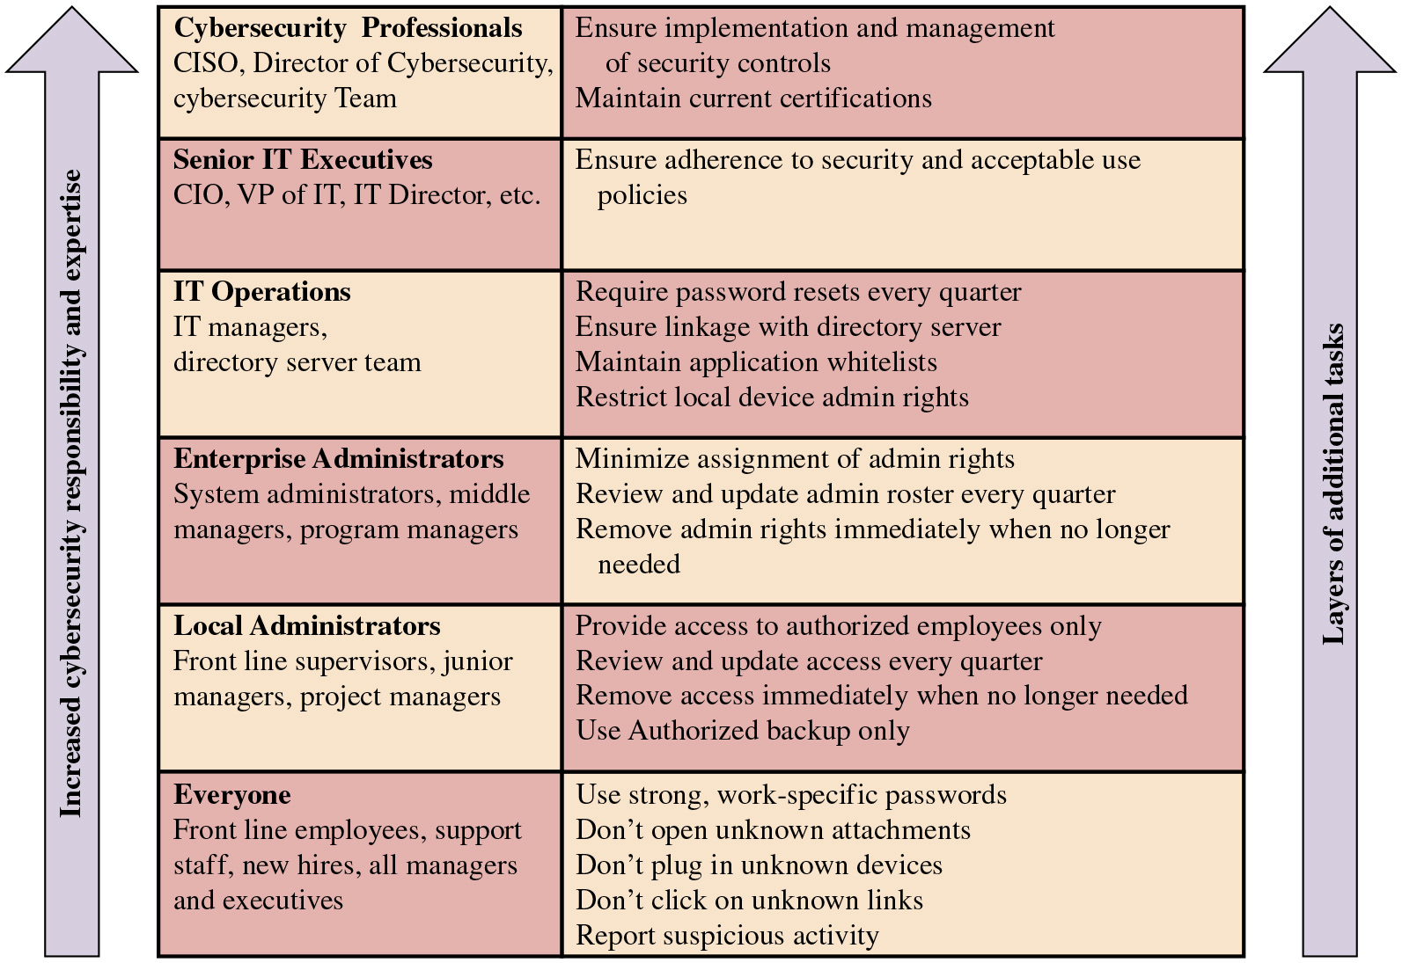
Figure 17.2
Security-Related Tasks by Job Description
Notes:
The Federal Financial Institutions Examination Council [F F I E 02] suggests that job descriptions be designed to increase accountability for security. Management can communicate general and specific security roles and responsibilities for all employees within their job descriptions. Management should expect all employees, officers, and contractors to comply with security and acceptable use policies and protect the institution’s assets, including information. The job descriptions for security personnel should describe the systems and processes they will protect and the control processes for which they are responsible. Management can take similar steps to ensure that contractors and consultants understand their security responsibilities as well.
A key aspect of clarifying the security responsibilities attached to a particular job description is to specify the cybersecurity tasks associated with each type of job. Figure 17.2, based on a figure in the Cybersecurity Workforce Handbook [C O C S 14], lists tasks that must be performed by everyone in the enterprise, with additional tasks assigned to those with increased responsibility for data and systems.
Long Description:
The table consists of 2 columns and 6 rows. The row entries are given as follows. Row 1: Column 1: Cybersecurity Professionals: C I S O, Director of Cybersecurity, cybersecurity Team. Column 2: Ensure implementation and management of security controls, Maintain current certifications. Row 2: Column 1: Senior I T Executives: C I O, V P of I T, I T Director, etc. Column 2: Ensure adherence to security and acceptable use policies. Row 3: Column 1: I T Operations: I T managers, directory server team. Column 2: Require password resets every quarter, Ensure linkage with directory server, Maintain application whitelists, Restrict local device admin rights. Row 4: Column 1: Enterprise Administrators: System administrators, middle managers, program managers. Column 2: Minimize assignment of admin rights, Review and update admin roster every quarter, Remove admin rights immediately when no longer needed. Row 5: Column 1: Local Administrators: Front line supervisors, junior managers, project managers. Column 2: Provide access to authorized employees only, Review and update access every quarter, Remove access immediately when no longer needed, Use Authorized backup only. Row 6: Column 1: Everyone: Front line employees, support staff, new hires, all managers and executives. Column 2: Use strong, work-specific passwords, Don’t open unknown attachments, Don’t plug in unknown devices, Don’t click on unknown links, Report suspicious activity.
Note: An upward arrow labeled Increased cybersecurity responsibility and expertise is shown on the left side of the table. Another upward arrow labeled Layers of additional tasks is shown on the right side of the table.

Slide 33
During Employment
Objectives with respect to current employees:
Ensure that employees, contractors, and third-party users are aware of information security threats and concerns and their responsibilities and liabilities with regard to information security
Are equipped to support the organizational security policy in their work
Reduce the risk of human error
Two essential elements of personnel security during employment are:
A comprehensive security policy document
An ongoing awareness and training program
Security principles:
Least privilege
Separation of duties - (see Nick Leeson of Barings Bank)
Limited reliance on key employees
Dual operator policy
Mandatory vacations
SJW
Notes:
I S O 27002 lists the following security objective with respect to current employees: to ensure that employees, contractors, and third-party users are aware of information security threats and concerns and their responsibilities and liabilities with regard to information security and are equipped to support organizational security policy in the course of their normal work and to reduce the risk of human error.
Two essential elements of personnel security during employment are (1) comprehensive security policy and acceptable use documents and (2) an ongoing awareness and training program for all employees, as we discuss in this chapter. In addition to enforcing the security policy in a fair and consistent manner, there are certain principles that should be followed for personnel security.
• Least privilege: Give each person the minimum access necessary to do their job. This restricted access is both logical (access to accounts, networks, and programs)
and physical (access to computers, backup tapes, and other peripherals). If every user has accounts on every system and has physical access to everything, then
all users are roughly equivalent in their level of threat.
• Separation of duties: Carefully separate duties so people involved in checking for inappropriate use are not also capable of making such inappropriate use. For example, one individual should not have overlapping security access and audit responsibilities. In that case, the individual can violate security policy and cover up any audit trail that would reveal the violation.
• Limited reliance on key employees: It is unavoidable that some employees are key to the operation of an organization, which creates risk. Therefore, organizations should have written policies and plans established for unexpected illness or departure. As with systems, redundancy should be built into the employee structure. There should be no single employee with unique knowledge or skills.
• Dual operator policy: In some cases, it may be possible to define specific tasks that require two people. A similar policy is two-person control, which requires that two employees approve each other’s work.
• Mandatory vacations: Mandatory vacation policies help expose employees involved in malicious activity, such as fraud or embezzlement. As an example,
employees in positions of fiscal trust, such as stock traders or bank employees, are often required to take an annual vacation of at least five consecutive workdays.

Slide 34
Termination of Employment
Termination security objectives:
Ensure employees, contractors, and third-party users exit organization or change employment in an orderly manner
The return of all equipment and the removal of all access rights are completed
Critical actions:
Remove name from all lists of authorized access
Ensure that no rogue admin accounts were created
Inform guards that ex-employee general access is not allowed
Remove personal access codes, change physical locks and lock combinations, reprogram access card systems
Recover employee I D, disks, documents, and equipment
Notify by memo or e-mail appropriate departments
Notes:
I S O 27002 lists the following security objective with respect to termination of employment: to ensure that employees, contractors, and third-party users exit an organization or change employment in an orderly manner, and that the return of all equipment and the removal of all access rights are completed.
The termination process is complex and depends on the nature of the organization, the status of the employee in the organization, and the reason for departure. From a security point of view, the following actions are important:
• Removing the person’s name from all lists of authorized access to applications and systems.
• For I T personnel, ensuring that no rogue admin accounts were created.
• Explicitly informing guards that the ex-employee is not allowed into the building without special authorization by named employees
• Removing all personal access codes
• If appropriate, changing lock combinations, reprogramming access card systems, and replacing physical locks
• Recovering all assets, including employee I D, disks, documents, and equipment (assets that should have been documented when provided to the employee).
• Notifying, by memo or e-mail, appropriate departments

Slide 35
Acceptable Use Policy (1 of 3)
Describes how users are allowed to use an organization’s assets
Defines acceptable and non-acceptable behaviors
Should be clear and concise and should be singed by each employee
Process for developing an A U P:
Conduct a risk assessment
Create the policy
Distribute the A U P
Monitor compliance
Enforce the policy
Notes:
An acceptable use policy (A U P) describes how users are allowed to use an organization’s assets. This policy is targeted at all employees who have access to one or more organization assets. It defines what behaviors are acceptable and what behaviors are not acceptable. The policy should be clear and concise, and it should be a condition of employment for each employee to sign a form indicating that they have read and understood the policy and agrees to abide by its conditions.
The MessageLabs white paper Acceptable Use Policies—Why, What, and How [N A Y L 09] suggests the following process for developing an A U P:
1. Conduct a risk assessment to identify areas of concern. As part of the risk assessment process that we discussed in Chapter 14, identify the elements that
need to go into an A U P.
2. Create the policy. The policy should be tailored to the specific risks identified, including liability costs. For example, the organization is exposed to liability if customer data is exposed. If the failure to protect the data is due to an employee’s action or inaction, and if this behavior violates the A U P, and if this policy is clear
and enforced, then this may mitigate the liability of the organization.
3. Distribute the A U P. This includes educating employees on why an A U P is necessary.
4. Monitor compliance. A procedure is needed to monitor and report on A U P compliance.
5. Enforce the policy. The A U P must be enforced consistently and fairly when it is breached.

Slide 36
Acceptable Use Policy (2 of 3)
Policy must include sections for:
The purpose and scope of the policy
The specific policy detail
Consequences for non-compliance
Areas covered by policy section:
General use and ownership
Security and proprietary information
Unacceptable use—system and network activities
Unacceptable use—e-mail and communication activities
Unacceptable use—blogging and social media
Notes:
The policy should include sections specifying the purpose and scope of the policy, the specific policy detail, and consequences for non-compliance. An example of a template for an A U P is provided by the S A N S Institute.2 The heart of the document is the policy section, which covers the following areas, with key points in each area noted:
General use and ownership:
• Employees must ensure that proprietary information is protected.
• Access to sensitive information is allowed only to the extent authorized and necessary to fulfill duties.
• Employees must exercise good judgment regarding the reasonableness of personal use.
Security and proprietary information:
• Mobile devices must comply with the company’s B Y O D policies.
• System- and user-level passwords must comply with the company’s password policy.
• Employees must use extreme caution when opening e-mail attachments.
Unacceptable use—system and network activities:
• Unauthorized copying of copyrighted material
• The prohibition against accessing data, a server, or an account for any purpose other than conducting company business, even with authorized access
• Revealing your account password to others or allowing use of your account by others
• Making statements about warranty unless it is a part of normal job duties
• Circumventing user authentication or security of any host, network, or account
• Providing information about, or lists of, company employees to outside parties
Unacceptable use—e-mail and communication activities:
• Any form of harassment
• Any form of spamming
• Unauthorized use, or forging, of e-mail header information
Unacceptable use—blogging and social media:
• Blogging is acceptable, provided that it is done in a professional and responsible manner, does not otherwise violate company policy, is not detrimental to company’s best interests, and does not interfere with an employee’s regular work duties.
• Any blogging that may harm or tarnish the image, reputation, and/or goodwill of company and/or any of its employees is prohibited.
• Employees may not attribute personal statements, opinions, or beliefs to the company.

Slide 37
Acceptable Use Policy (3 of 3)
An individual or a group must be designated to monitor the implementation of the security policy
They must review policies and make any changes needed
A violation-reporting mechanism is needed to encourage employees to report.
SJW
Notes:
The organization should designate an individual or a group responsible for monitoring the implementation of the security policy. The responsible entity should periodically review policies and make any changes needed to reflect changes in the organization’s environment, asset suite, or business procedures. A violation-reporting mechanism is needed to encourage employees to report.

Slide 38

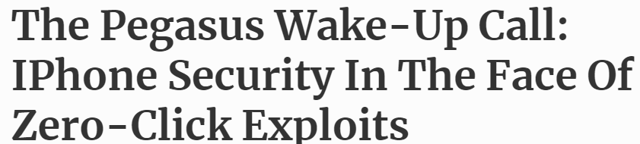
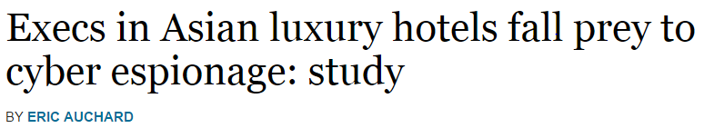
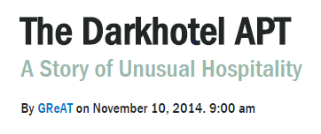
Travel Policy
BlastPass - CitizenLab 9/2023
Bring “loaner” device
Erase before leaving U.S.
Wipe clean after return
Disable Bluetooth, Wi-Fi
Connect to Internet using encryption
Remove cellphone battery at meetings
Paste password from flash drive (avoid key-loggers)
Switch off microphone and camera
SJW

Slide 39
Security Incident Response
Response procedures to incidents are an essential control for most organizations
Procedures need to reflect possible consequences of an incident on the organization and allow for a suitable response
Developing procedures in advance can help avoid panic
Benefits of having incident response capability:
Systematic incident response
Quicker recovery to minimize loss, theft, disruption of service
Use information gained during incident handling to better prepare for future incidents
Dealing properly with legal issues that may arise during incidents
Notes:
The development of procedures to respond to computer incidents is regarded as an essential control for most organizations. Most organizations will experience some form of security incident sooner rather than later. Typically, most incidents relate to risks with lesser impacts on the organization, but occasionally a more serious incident can occur. The incident handling and response procedures need to reflect the range of possible consequences of an incident on the organization and allow for a suitable response. By developing suitable procedures in advance, an organization can avoid the panic that occurs when personnel realize that bad things are happening and are not sure of the best response.
N I S T S P 800-61 [Computer Security Incident Handling Guide, August 2012) lists the following benefits of having an incident response capability:
• Responding to incidents systematically so the appropriate steps are taken
• Helping personnel to recover quickly and efficiently from security incidents, minimizing loss or theft of information and disruption of services
• Using information gained during incident handling to better prepare for handling future incidents and to provide stronger protection for systems and data
• Dealing properly with legal issues that may arise during incidents

Slide 40
Computer Security Incident Response Team (C S I R T)
C S I R T s are responsible for:
Rapidly detecting incidents
Minimizing loss and destruction
Mitigating the weaknesses that were exploited
Restoring computing services
Notes:
For large and medium-sized organizations, a computer security incident response team (C S I R T) is responsible for rapidly detecting incidents, minimizing loss and destruction, mitigating the weaknesses that were exploited, and restoring computing services.

Slide 41
Security Incidents
“Any action that threatens one or more of the classic security services of confidentiality, integrity, availability, accountability, authenticity, and reliability in a system”
Unauthorized access to a system
Accessing information not authorized to see
Passing information on to a person not authorized to see it
Attempting to circumvent the access mechanisms
Using another person’s user I D and password
Unauthorized modification of information on the system
Attempting to corrupt information that may be of value
Attempting to modify information without authority
Processing information in an unauthorized manner
Notes:
There is a range of events that can be regarded as a security incident. Indeed any action that threatens one or more of the classic security services of confidentiality, integrity, availability, accountability, authenticity, and reliability in a system constitutes an incident. These include various forms of unauthorized access to a system, and unauthorized modification of information on the system. Unauthorized access to a system by a person includes
• Accessing information that person is not authorized to see
• Accessing information and passing it on to another person who is not authorized to see it
• Attempting to circumvent the access mechanisms implemented on a system
• Using another person’s user I D and password for any purpose
• Attempting to deny use of the system to any other person without authorization to do so
Unauthorized modification of information on a system by a person includes
• Attempting to corrupt information that may be of value to another person
• Attempting to modify information and/or resources without authority
• Processing information in an unauthorized manner

Slide 42
Table 17.2 (1 of 2)
Security Incident Terminology
Artifact
Any file or object found on a system that might be involved in probing or attacking systems and networks or that is being used to defeat security measures. Artifacts can include, but are not limited to, computer viruses, Trojan horse programs, worms, exploit scripts, and toolkits.
Computer Security Incident Response Team (C S I R T)
A capability set up for the purpose of assisting in responding to computer security-related incidents that involve sites within a defined constituency; also called a computer incident response team (C I R T) or a C I R C (Computer Incident Response Center, Computer Incident Response Capability).
Constituency
The group of users, sites, networks, or organizations served by the C S I R T.
Notes:
Managing security incidents involves procedures and controls that address [C A R N 03]:
• Detecting potential security incidents
• Sorting, categorizing, and prioritizing incoming incident reports
• Identifying and responding to breaches in security
• Documenting breaches in security for future reference
Table 17.2 lists key terms related to computer security incident response.

Slide 43
Table 17.2 (2 of 2)
Security Incident Terminology
Incident
A violation or imminent threat of violation of computer security policies, acceptable use policies, or standard security practices.
Triage
The process of receiving, initial sorting, and prioritizing of information to facilitate its appropriate handling.
Vulnerability
A characteristic of a piece of technology which can be exploited to perpetrate a security incident. For example, if a program unintentionally allowed ordinary users to execute arbitrary operating system commands in privileged mode, this “feature” would be a vulnerability.

Slide 44

Detecting Incidents
Incidents may be detected by users or administration staff
Staff should be encouraged to make reports of system malfunctions or anomalous behaviors
Automated tools
System integrity verification tools
Log analysis tools
Network and host intrusion detection systems (I D S)
Intrusion prevention systems
SJW
Notes:
Security incidents may be detected by users or administration staff who report a system malfunction or anomalous behavior. Staff should be encouraged to make such reports. Staff should also report any suspected weaknesses in systems. The general security training of staff in the organization should include details of who to contact in such cases.
Security incidents may also be detected by automated tools, which analyze information gathered from the systems and connecting networks. We discuss a range of such tools in Chapter 8. These tools may report evidence of either a precursor to a possible future incident or indication of an actual incident occurring. Tools that can detect incidents include the following:
• System integrity verification tools: Scan critical system files, directories, and services to ensure they have not been changed without proper authorization.
• Log analysis tools: Analyze the information collected in audit logs using some form of pattern recognition to identify potential security incidents.
• Network and host intrusion detection systems (I D S): Monitor and analyze network and host activity and usually compare this information with a collection of attack signatures to identify potential security incidents.
• Intrusion prevention systems: Augment an intrusion detection system with the ability to automatically block detected attacks. Such systems need to be used with care because they can cause problems if they respond to a misidentified attack and reduce system functionality when not justified. We discuss such systems in Chapter 9.
The effectiveness of such automated tools depends greatly on the accuracy of their configuration and the correctness of the patterns and signatures used. The tools need to be updated regularly to reflect new attacks or vulnerabilities. They also need to distinguish adequately between normal, legitimate behavior and anomalous attack behavior. This is not always easy to achieve and depends on the work patterns of specific organizations and their systems. However, a key advantage of automated systems that are regularly updated is that they can track changes in known attacks and vulnerabilities. It is often difficult for security administrators to keep pace with the rapid changes to the security risks to their systems and to respond with patches or other changes needed in a timely manner. The use of automated tools can help reduce the risks to the organization from this delayed response.
The decision to deploy automated tools should result from the organization’s security goals and objectives and specific needs identified in the risk assessment process. Deploying these tools usually involves significant resources, both monetary and personnel time. This needs to be justified by the benefits gained in reducing risks.
Whether or not automated tools are used, the security administrators need to monitor reports of vulnerabilities and to respond with changes to their systems if necessary.

Slide 45
Triage Function
Goal:
Ensure that all information destined for the incident-handling service is channeled through a single focal point
Commonly achieved by advertising the triage function as the single point of contact for the whole incident-handling service
Responds to incoming information by:
Requesting additional information in order to categorize the incident
Notifying the various parts of the enterprise or constituency about the vulnerability and shares information about how to fix or mitigate the vulnerability
Identifies the incident as either new or part of an ongoing incident and passes this information on to the incident handling response function
Notes:
The goal of this function is to ensure that all information destined for the incident-handling service is channeled through a single focal point regardless of the method by which it arrives (e.g., by e-mail, hotline, helpdesk, I D S) for appropriate redistribution and handling within the service. This goal is commonly achieved by advertising the triage function as the single point of contact for the whole incident-handling service. The triage function responds to incoming information in one or more of the following ways:
1. The triage function may need to request additional information in order to categorize the incident.
2. If the incident relates to a known vulnerability, the triage function notifies the various parts of the enterprise or constituency about the vulnerability and shares information about how to fix or mitigate the vulnerability.
3. The triage function identifies the incident as either new or part of an ongoing incident and passes this information on to the incident handling response function in priority order.

Slide 46
Responding to Incidents
Must have documented procedures to respond to incidents
Procedures should:
Detail how to identify the cause
Describe the action taken to recover from the incident
Identify typical categories of incidents and the approach taken to respond to them
Identify management personnel responsible for making critical decisions and how to contact them
Identify the circumstances when security breaches should be reported to third parties such as the police or relevant C E R T
Notes:
Once a potential incident is detected, there must be documented procedures to respond to it. [C A R N 03] lists the following potential response activities:
• Taking action to protect systems and networks affected or threatened by intruder activity
• Providing solutions and mitigation strategies from relevant advisories or alerts
• Looking for intruder activity on other parts of the network
• Filtering network traffic
• Rebuilding systems
• Patching or repairing systems
• Developing other response or workaround strategies
Response procedures must detail how to identify the cause of the security incident, whether accidental or deliberate. The procedures then must describe the action taken to recover from the incident in a manner that minimizes the compromise or harm to the organization. It is clearly impossible to detail every possible type of incident. However, the procedures should identify typical categories of such incidents and the approach taken to respond to them. Ideally, these should include descriptions of possible incidents and typical responses. They should also identify the management personnel responsible for making critical decisions affecting the organization’s systems and how to contact them at any time when an incident is occurring. This is particularly important in circumstances such as the mass e-mail worm infection we described when the response involves trading off major loss of functionality against further significant systems compromise. Such decisions will clearly affect the organization’s operations and must be made very quickly. N I S T S P 800-61 lists the following broad categories of security incidents that should be addressed in incident response policies:
• Denial-of-service attacks that prevent or impair normal use of systems
• Malicious code that infects a host
• Unauthorized access to a system
• Inappropriate usage of a system in violation of acceptable use policies
• Multiple-component incidents, which involve two or more of the above categories in a single incident
In determining the appropriate responses to an incident, a number of issues should be considered. These include how critical the system is to the organization’s function and the current and potential technical effect of the incident in terms of how significantly the system has been compromised.
The response procedures should also identify the circumstances when security breaches should be reported to third parties, such as the police or relevant C E R T (computer emergency response team) organization. There is a high degree of variance among organizational attitudes to such reports. Making such reports clearly helps third parties monitor the overall level of activity and trends in computer crimes. However, particularly if legal action could be instituted, it may be a liability for the organization to gather and present suitable evidence. While the law may require reporting in some circumstances, there are many other types of security incidents when the response is not prescribed. Hence, it must be determined in advance when such reports would be regarded as appropriate for the organization. There is also a chance that if an incident is reported externally, it might be reported in the public media. An organization should identify how it would respond in general to such reports.
For example, an organization could decide that cases of computer-assisted-fraud should be reported to both the police and the relevant C E R T with the aim of prosecuting the culprit and recovering any losses. It is often now required by law that breaches of personal information must be reported to the relevant authorities and that suitable responses must be taken. However, an incident such as a website defacement is unlikely to lead to a successful prosecution. Hence, the policy might be for the organization to report these to the relevant C E R T, to take steps in response to restore functionality as quickly as possible, and to minimize the possibility of a repeat attack.
As part of the response to an incident, evidence is gathered about the incident. Initially this information is used to help recover from the incident. If the incident is reported to the police, then this evidence may also be needed for legal proceedings. In this case, it is important that careful steps are taken to document the collection process for the evidence and its subsequent storage and transfer. If this is not done in accordance with the relevant legal procedures, it is likely the evidence will not be admissible in court. The procedures required vary from country to country. N I S T S P 800-61 includes some guidance on this issue.

Slide 47
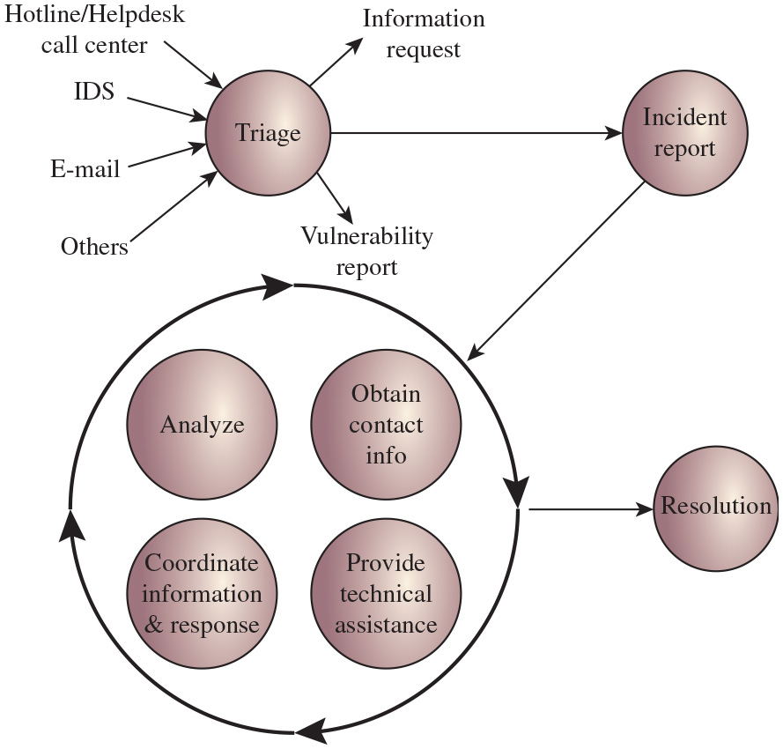
Figure 17.3
Incident Handling Life Cycle
Notes:
Figure 17.3 illustrates a typical incident-handling life cycle. Once an incident is opened, it transitions through a number of states with all the information relating to the incident (its change of state and associated actions) until no further action is required from the team’s perspective, and the incident is finally closed. The cyclical portion of Figure 17.3 (lower left) indicates those states that may be visited multiple times during the activity’s life cycle. Hotline slash Helpdesk call center, I D S, Email, and others are fed to the Triage. Information request and vulnerability report emerge out from the triage. The triage output is fed to the cycle through the incident report. The cycle involves analyze, Coordinate information and response, Obtain contact info, and Provide technical assistance. The output of the cycle is fed to the Resolution.
Long Description:
The diagram consists of seven circular blocks labeled triage, incident report, analyze, obtain contact info, coordinate information and response, provide technical assistance, and resolution. A circle with four arrows is marked on it in the clockwise direction. The blocks labeled analyze, obtain contact info, coordinate information and response, and provide technical assistance are arranged inside the circle, and the remaining three are shown outside the circle. The triage block is shown above the circle, the incident report is shown right of the triage. The resolution is shown right of the circle. Three arrows labeled hotline slash helpdesk call center I D S, email, and others are pointing to the triage block. Two arrows labeled information request and vulnerability report are pointing toward the upper right and lower right directions from the triage block. An arrow from the triage block is connected to the incident report block. An arrow from the circle connected to the resolution block. An arrow from the incident report block connected to the circle.

Slide 48
Documenting Incidents
Should immediately follow a response to an incident
Identify what vulnerability led to its occurrence
How this might be addressed to prevent the incident in the future
Details of the incident and the response taken
Impact on the organization’s systems and its risk profile
Notes:
Following the immediate response to an incident, there is a need to identify what vulnerability led to its occurrence and how this might be addressed to prevent the incident in the future. Details of the incident and the response taken are recorded for future reference. The impact on the organization’s systems and its risk profile must also be reconsidered as a result of the incident.
This typically involves feeding the information gathered as a result of the incident back to an earlier phase of the IT security management process. It is possible that the incident was an isolated rare occurrence, and the organization was simply unlucky for it to occur. More generally, though, a security incident reflects a change in the risk profile of the organization that needs to be addressed. This could involve reviewing the risk assessment of the relevant systems and either changing or extending this analysis. It could involve reviewing controls identified for some risks, strengthening existing controls, and implementing new controls. This reflects the cyclic process of IT security management.

Slide 49
Table 17.3
Examples of Possible Information Flow to and from the Incident-Handling Service
Service name | Information flow to incident handling | Information flow from incident handling
Announcements | Warning of current attack scenario | Statistics or status report New attack profiles to consider or research
Vulnerability Handling | How to protect against exploitation of specific vulnerabilities | Possible existence of new vulnerabilities
Malware Handling | Information on how to recognize use of specific malware Information on malware impact/threat | Statistics on identification of malware in incidents New malware sample
Education/Training | None | Practical examples and motivation knowledge
Intrusion Detection Services | New incident report | New attack profile to check for
Security Audit or Assessments | Notification of penetration test start and finish schedules | Common attack scenarios
Security Consulting | Information about common pitfalls and the magnitude of the threats | Practical examples/experiences
Risk Analysis | Information about common pitfalls and the magnitude of the threats | Statistics or scenarios of loss
Technology Watch | Warn of possible future attack scenarios Alert to new tool distribution | Statistics or status report New attack profiles to consider or research
Development of Security Tools | Availability of new tools for constituency use | Need for products Provide view of current practices
Notes:
A number of services are either a part of or interact with the incident-handling function. Table 17.3 [C A R N 03] provides examples of the information flow to and from an incident-handling service. This type of breakdown is useful in organizing and optimizing the incident-handling service and in training personnel on the requirements for incident handling and response.

Slide 50
Summary
Security awareness, training, and education
Motivation
A learning continuum
Security awareness
Cybersecurity basics and literacy
Role-based training
Education and certification
Employment practices and policies
Security in the hiring process
During employment
Termination of employment
Acceptable use policy
Computer security incident response teams
Detecting incidents
Triage function
Responding to incidents
Documenting incidents
Information flow for incident handling
Notes:
Chapter 17 summary.

Slide 51

Copyright
This work is protected by United States copyright laws and is provided solely for the use of instructors in teaching their courses and assessing student learning. Dissemination or sale of any part of this work (including on the World Wide Web) will destroy the integrity of the work and is not permitted. The work and materials from it should never be made available to students except by instructors using the accompanying text in their classes. All recipients of this work are expected to abide by these restrictions and to honor the intended pedagogical purposes and the needs of other instructors who rely on these materials.

